Slide 1

NETFLIX Data Analysis
Using SQL >>>>>>>>>

Slide 2
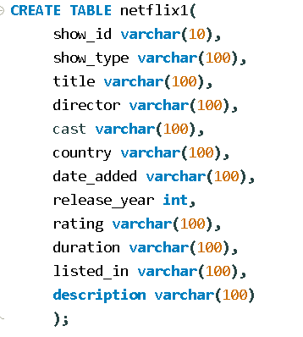
Table Creation

Slide 3
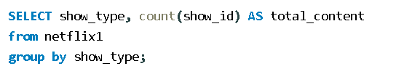
Q.1 Count the number of Movies vs TV show.

Slide 4
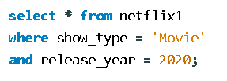
Q.2 List of all Movies released in a specific year..

Slide 5
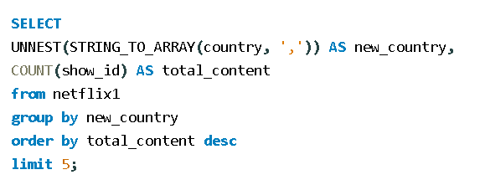
Q.3 Find the top 5 countries with the most content on Netflix.

Slide 6
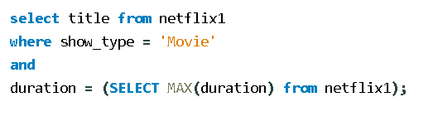
Q.4 Identify the longest movies.

Slide 7
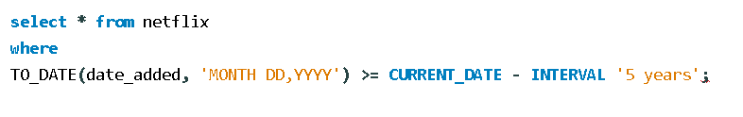
Q.5 find content added in last 5 years.

Slide 8

Q.6 Find all movies/TV shows by director ‘rajiv chilaka’

Slide 9
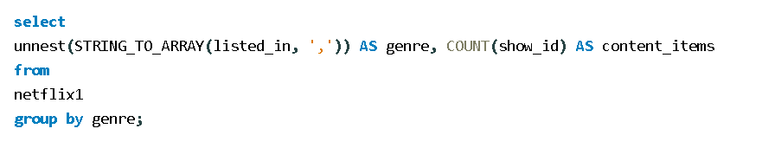
Q.7 Count the number of content items in each genre.

Slide 10
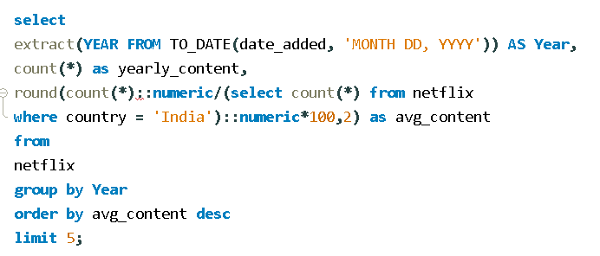
Q.8 Find each year and the average numbers of content release in india on Netflix,return top 5 years with highest average releases.

Slide 11
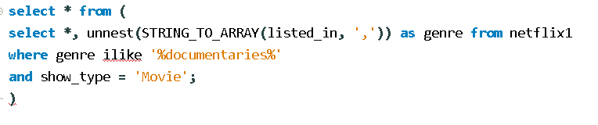
Q.9 List all movies that are documentaries.

Slide 12

Q.10 Find all Content without a director.

Slide 13
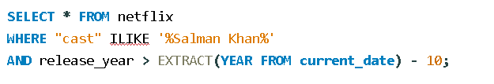
Q.11 Find how many movies actor ‘Salman Khan’ appeared in the last 10 years.

Slide 14
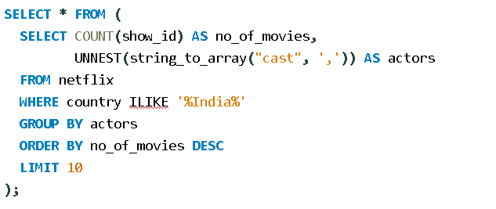
Q.12 Find top 10 Actors who haved appeared in the highest number of movies produced in india.

Slide 15
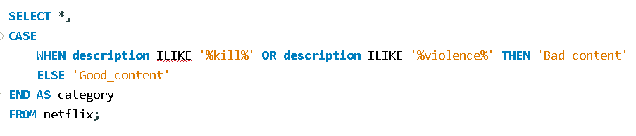
Q.13 Categorizes the content as “good” or “bad” based on Keywords like “kill” and “violence” in the description.

